Slide 1





TNWISE2026
TAMIL NADU HACKATHON FOR WOMEN IN SCIENCE & ENGINEERING
THEME:
SUB -THEME:
TITLE:
REF NUMBER:
TEAM LEADER:
COLLEGE:

Slide 2
PROBLEM STATEMENT
There is a need to identify practical solutions to real-world challenges by applying engineering and scientific knowledge. Existing approaches often lack innovation, scalability, or alignment with societal and industrial needs. This problem requires students to analyze the situation, propose effective solutions, and demonstrate their ideas through structured problem-solving and innovation.

Slide 3
PROJECT GOALS
Identify and understand the given problem statement
Apply scientific and engineering principles to develop feasible solutions
Encourage innovative thinking and creativity
Design solutions aligned with real-world and societal needs
Enhance teamwork, problem-solving, and presentation skills
Demonstrate the proposed solution through models, simulations, or prototypes

Slide 4

METHODOLOGY
RESEARCH APPROACH
Understand and analyze the problem statement
Review relevant background information and existing solutions
Define objectives and success criteria
Develop concepts and possible solution approaches
Select the most feasible and effective solution
Design and implement the proposed solution
Test, evaluate, and refine the solution
Document results and present outcomes

Slide 5
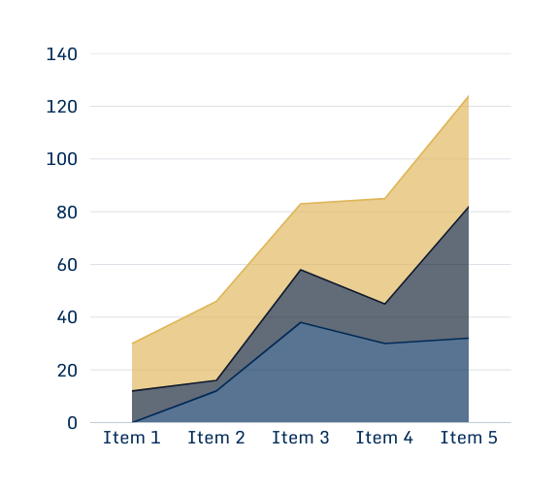
RESULT
Developed a workable solution addressing the identified problem
Achieved the defined project objectives successfully
Improved efficiency, performance, or impact compared to existing approaches
Validated the solution through testing, simulation, or demonstration
Identified strengths and limitations of the proposed solution
Generated insights for further improvement and future work

Slide 6
BUSINESS MODEL & COST
Value Proposition: Affordable and effective solution addressing a real-world problem
Target Customers: Individuals, institutions, or industries relevant to the problem domain
Revenue Model: Product sales, service charges, subscriptions, or licensing
Cost Components:
Product development and design
Raw materials / software tools
Manufacturing or deployment
Operations and maintenance
Marketing and distribution
Pricing Strategy: Competitive pricing with cost recovery and profit margin
Break-even Outlook: Achievable through scale and optimized operations
Scalability: Cost per unit reduces with increased production or adoption

Slide 7
CONCLUSION
The project successfully addressed the defined problem statement
A feasible and innovative solution was developed and demonstrated
The objectives of the project were achieved effectively
The proposed approach shows potential for real-world application
Further improvements and scaling can enhance impact and sustainability

Slide 8
TEAM MEMBERS DETAILS
LEADER:
SEM:
DEPARTMENT:
YEAR:
MEMBER 1:
SEM:
DEPARTMENT:
YEAR:
MEMBER 2:
SEM:
DEPARTMENT:
YEAR:
MENTOR:
DESIGNATION:
DEPARTMENT:
COLLEGE / INDUSTRY NAME:

Slide 9
THANK YOU

